Slide 1
the standard Basis
A collection of structures provided by SML.

Slide 2
The Standard Basis
The Standard Basis is a collection of structures provided by ML. These structures define useful general purpose datatypes.
The Standard Basis includes the following structures.
Int, Real, Bool, String, Char, Word, TextIO, List, Array, Math, Substring, Vector, Option, OS, Time, Timer, General, Date

Slide 3
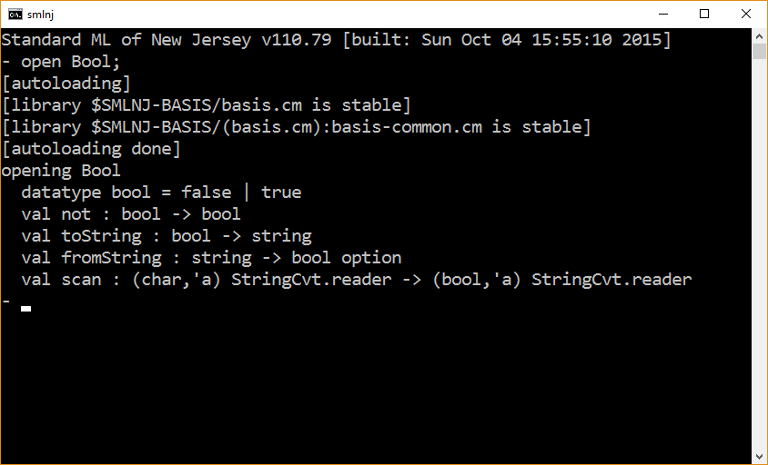

Slide 4
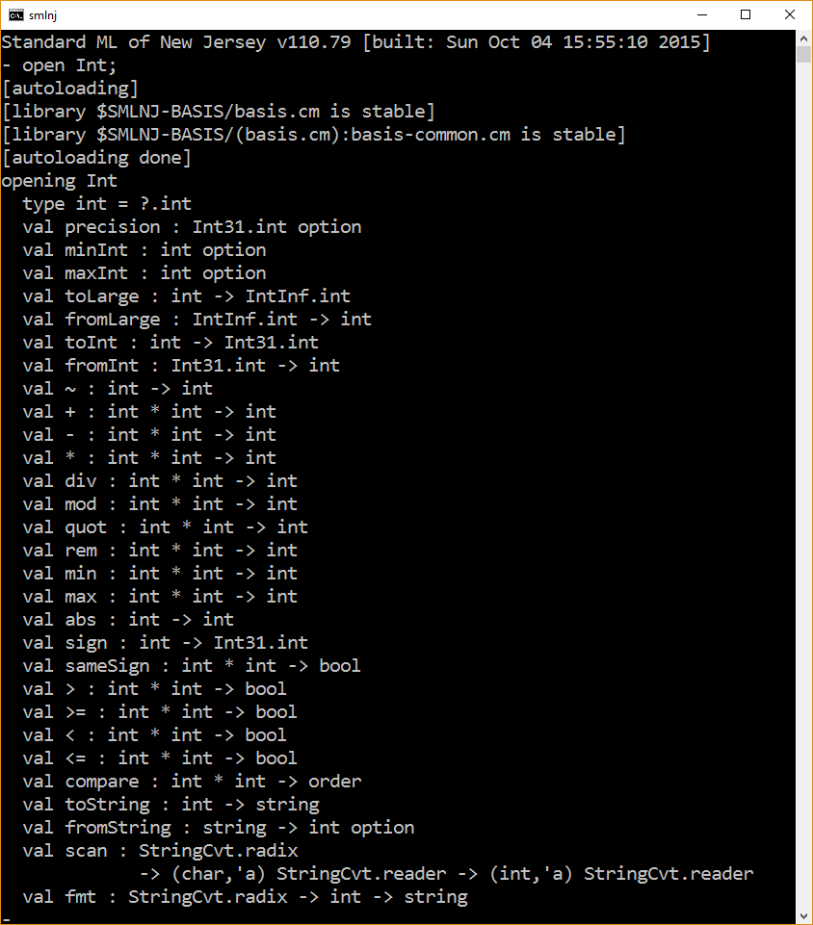

Slide 5
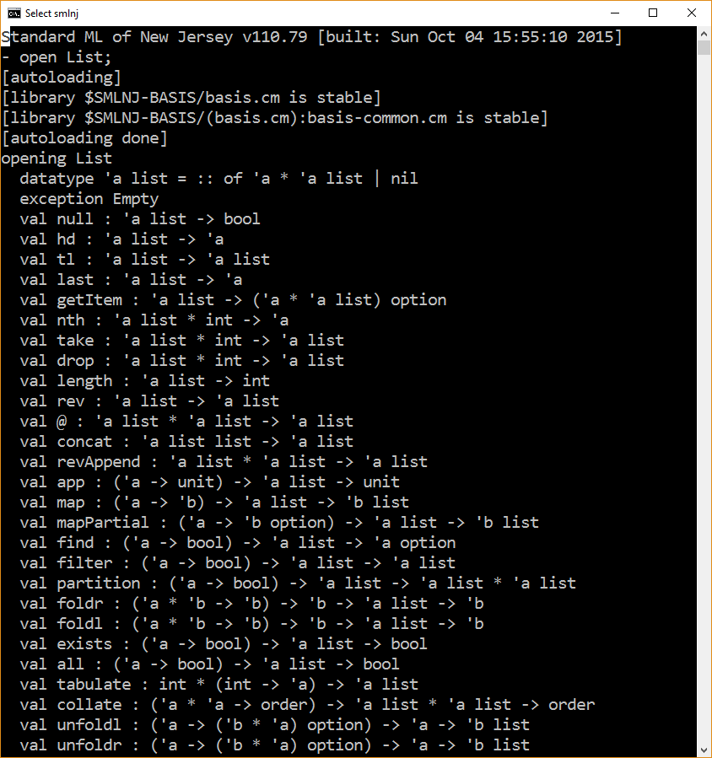

Slide 6
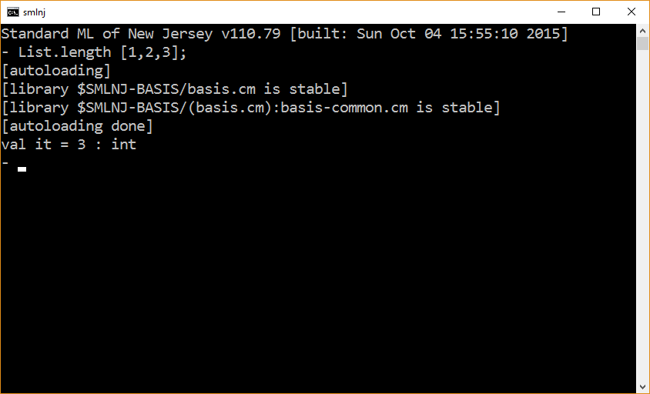

Slide 7
The Top-level Environment
SML’s version of m0

Slide 8
The top-level environment
The top-level environment provides direct access to various values (e.g., functions) that are defined in structures belonging to the standard basis.
One way to think of the top-level environment is that it partially opens the structures in the standard basis.
Note: At the interpreter prompt, when you enter a declaration, you are adding to the top-level environment.

Slide 9
- open List;
opening List
datatype 'a list = :: of 'a * 'a list | nil
exception Empty
val null : 'a list -> bool
val hd : 'a list -> 'a
val tl : 'a list -> 'a list
val last : 'a list -> 'a
val getItem : 'a list -> ('a * 'a list) option
val nth : 'a list * int -> 'a
val take : 'a list * int -> 'a list
val drop : 'a list * int -> 'a list
val length : 'a list -> int
val rev : 'a list -> 'a list
val @ : 'a list * 'a list -> 'a list
val concat : 'a list list -> 'a list
val revAppend : 'a list * 'a list -> 'a list
val app : ('a -> unit) -> 'a list -> unit
val map : ('a -> 'b) -> 'a list -> 'b list
val mapPartial : ('a -> 'b option) -> 'a list -> 'b list
val find : ('a -> bool) -> 'a list -> 'a option
val filter : ('a -> bool) -> 'a list -> 'a list
val partition : ('a -> bool) -> 'a list -> 'a list * 'a lis
val foldr : ('a * 'b -> 'b) -> 'b -> 'a list -> 'b
val foldl : ('a * 'b -> 'b) -> 'b -> 'a list -> 'b
val exists : ('a -> bool) -> 'a list -> bool
val all : ('a -> bool) -> 'a list -> bool
val tabulate : int * (int -> 'a) -> 'a list
Examples of what is visible in the top-level environment

Slide 10
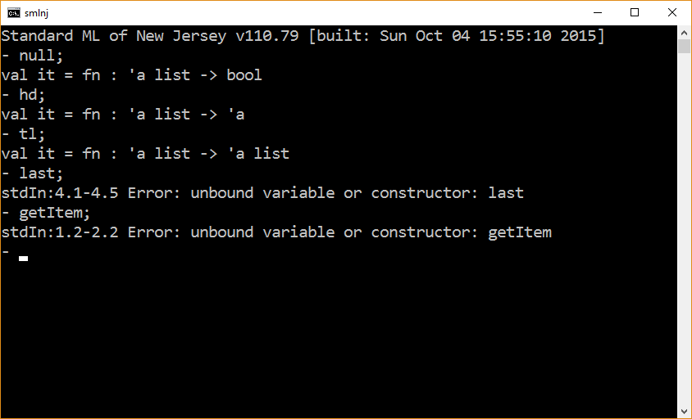

Slide 11
The End

